Slide 1

REVO.SOL
Always effective

Slide 2
Our team
Bassem
Youstina
Ahmed / Gilan
Mohamed
Application consultant managers
Project manager
Sales manager
Training manager

Slide 3

Who we are

Slide 4



Our clients

Slide 5
“Every problem is a gift. Without problems we would not grow .”
Anthony Robbins

Slide 6
Problem
Solution

Slide 7


Slide 8

Proposal
HR & Payroll

Slide 9
PLANS
Standard system
0-1000 users
50% customization
1001-10000 users
100% customization
+10000 users
BASIC
PRO
PREMIUM

Slide 10
TIMING
DAY 1
Business Proposal
DAY 14
DAY 7
First prototype
Technical meeting
DAY 21
DAY 28
Final system
Training period

Slide 11
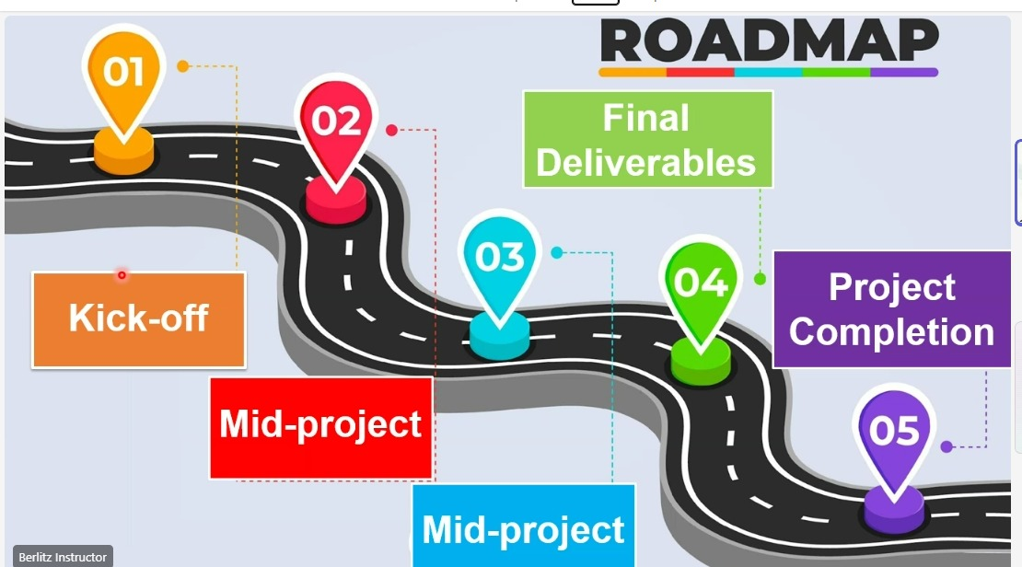

Slide 12
From Waterfall to Agile/Scrum
Waterfall:
1. Fixed steps
2. Delays in deliverables
Agile/Scrum:
1. Work divided into Sprints
2. Daily Stand-ups
3. Sprint Reviews & Retrospectives
4. Clear Scrum roles (Scrum Master, Product Owner)

Slide 13
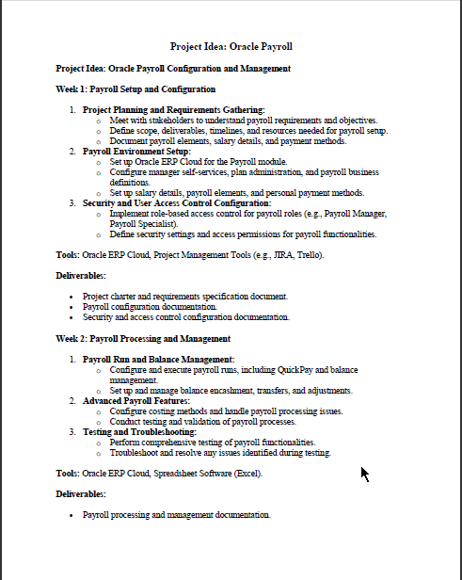
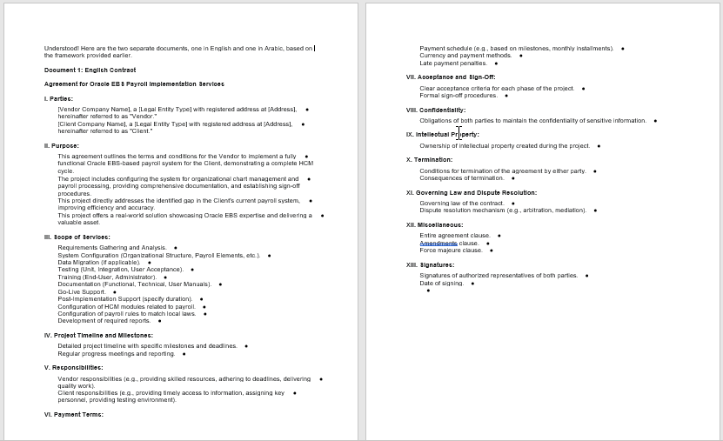
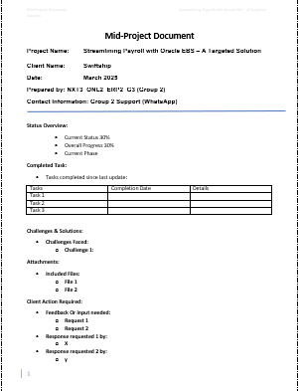
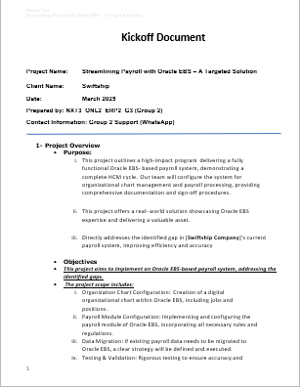
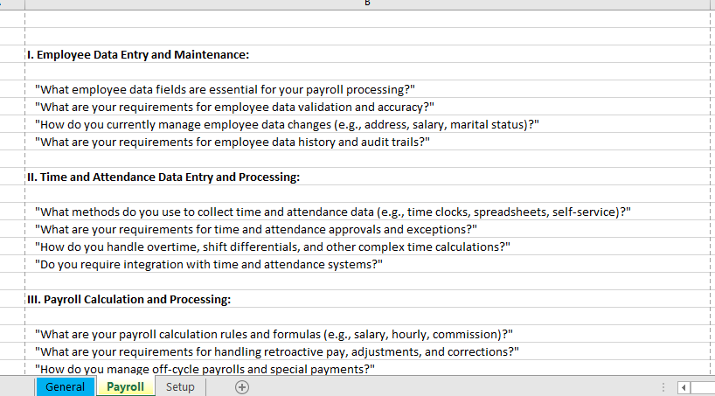
Documentation

Slide 14
DocuSign – Digital Transformation of Paper -Based Processes
Challenges with traditional methods:
Delays
Document loss
Tracking issues

Slide 15
DocuSign:
E-signature platform
Secure and encrypted
Fast and efficient
DocuSign integration in the project:
Signing payroll approvals, requirement documents, and contracts
Reducing time and cost

Slide 16


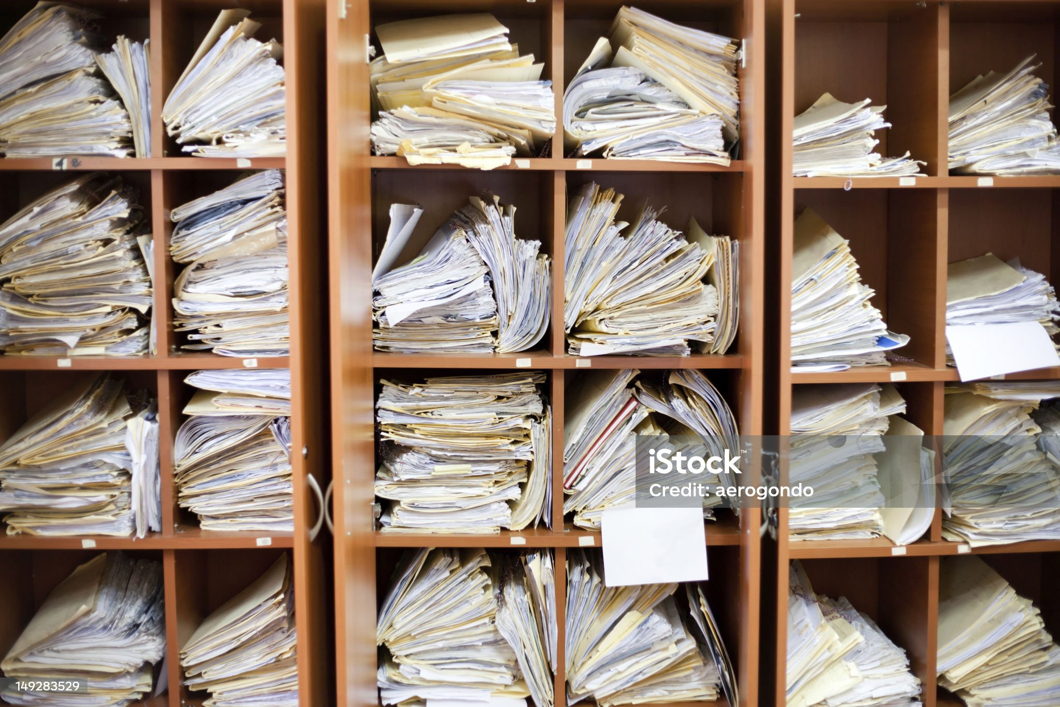

Slide 17
Smart Transformation for HR Management
Challenges:
1.Payroll Management
2.Recruitment Process
3. Performance Evaluation

